Slide 1
Day 1 Types, Variables, Operators

Slide 2
Goal
Introduction To Java
How to Run Programs in Java

Slide 3



The Computer
Memory
Central Processing Unit (CPU)
Input/Output (IO) Devices

Slide 4
CPU Instructions
Read location x Read location y Add
Write to location z
z = x + y

Slide 5
Programming Languages
Easier to understand than CPU instructions
Needs to be translated for the CPU to understand it

Slide 6
Java
“Most popular” language
Runs on a “virtual machine” (JVM)
More complex than some (eg. Python)
Simpler than others (eg. C++)

Slide 7




Compiling Java
Source Code (.java)
Byte Code (.class)
javac
java

Slide 8
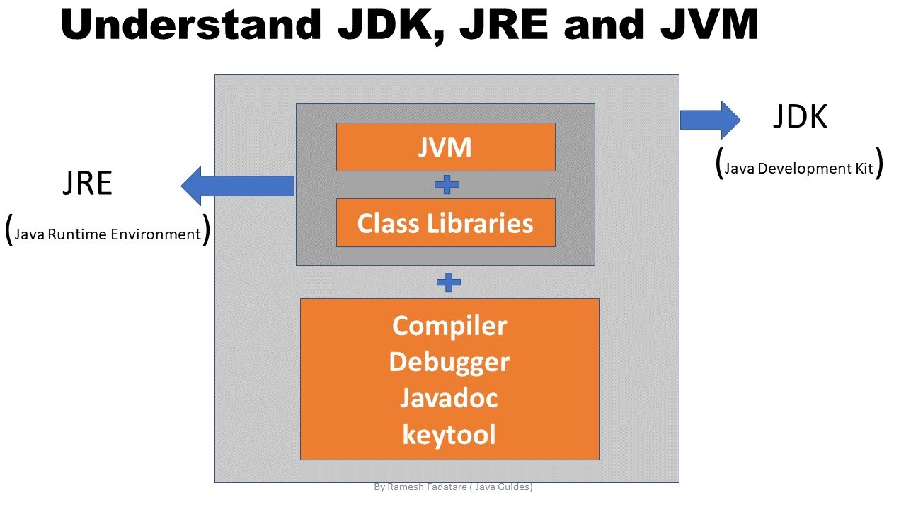

Slide 9
First Program
class Hello {
public static void main(String[] arguments) {
// Program execution begins here System.out.println("Hello world.");
}
}

Slide 10
Program Structure
class CLASSNAME {
public static void main(String[] arguments) {
STATEMENTS
}
}

Slide 11
Output
System.out.println(some String) outputs to the console
Example: System.out.println(“output”);

Slide 12
Second Program
class Hello2 {
public static void main(String[] arguments) { System.out.println("Hello world."); // Print once System.out.println("Line number 2"); // Again!
}
}

Slide 13
Types
Kinds of values that can be stored and manipulated.
boolean: Truth value (true or false). int: Integer (0, 1, -47).
double: Real number (3.14, 1.0, -2.1).
String: Text (“hello”, “example”).

Slide 14
Variables
Named location that stores a value of one particular type.
Form:
TYPE NAME;
Example: String foo;

Slide 15
Assignment
Use = to give variables a value.
Example: String foo;
foo = “IAP 6.092”;

Slide 16
Assignment
Can be combined with a variable declaration.
Example:
double badPi = 3.14; boolean isJanuary = true;

Slide 17
class Hello3 {
public static void main(String[] arguments) { String foo = "IAP 6.092"; System.out.println(foo);
foo = "Something else";
System.out.println(foo);
}
}

Slide 18
Operators
Symbols that perform simple computations
Assignment: = Addition: + Subtraction: - Multiplication: * Division: /

Slide 19
Order of Operations
Follows standard math rules:
Parentheses
Multiplication and division
Addition and subtraction

Slide 20
class DoMath {
public static void main(String[] arguments) { double score = 1.0 + 2.0 * 3.0; System.out.println(score);
score = score / 2.0; System.out.println(score);
}
}

Slide 21
class DoMath2 {
public static void main(String[] arguments) { double score = 1.0 + 2.0 * 3.0; System.out.println(score);
double copy = score;
copy = copy / 2.0; System.out.println(copy); System.out.println(score);
}
}

Slide 22
String Concatenation (+)
String text = "hello" + " world"; text = text + " number " + 5;
// text = "hello world number 5"

Slide 23
Student Activity using Visual Studio Code
Example1.java
Example2.java
Test yourskills.java

